Slide 1
Upload and Multipart Upload

Slide 2
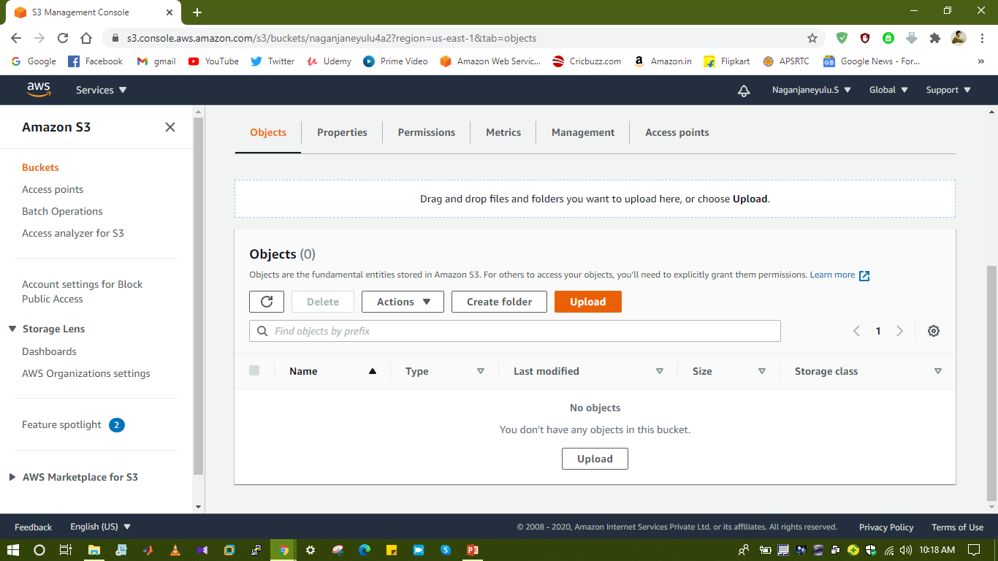
Upload

Slide 3
Multipart Upload
Multipart upload allows to upload a single object as a set of parts.
The following technical specifications apply to multipart uploads:
1 to 1000 parts per object
5 MB to 5 GB per part
Each object stores up to 5TB
To upload multipart we are using AWS CLI.
We need to install AWS CLI and IAM user with access of S3.

Slide 4
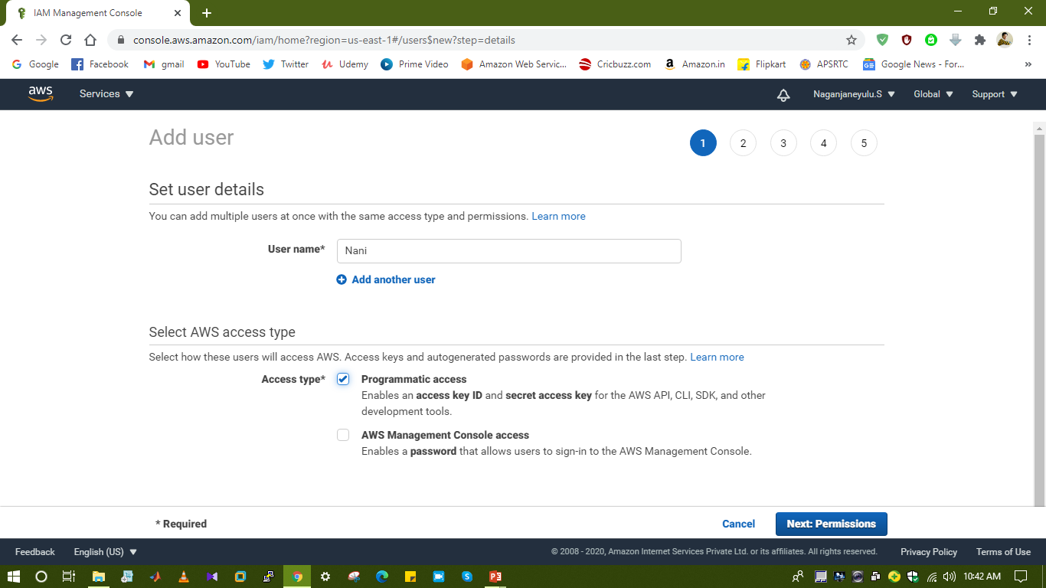

Slide 5
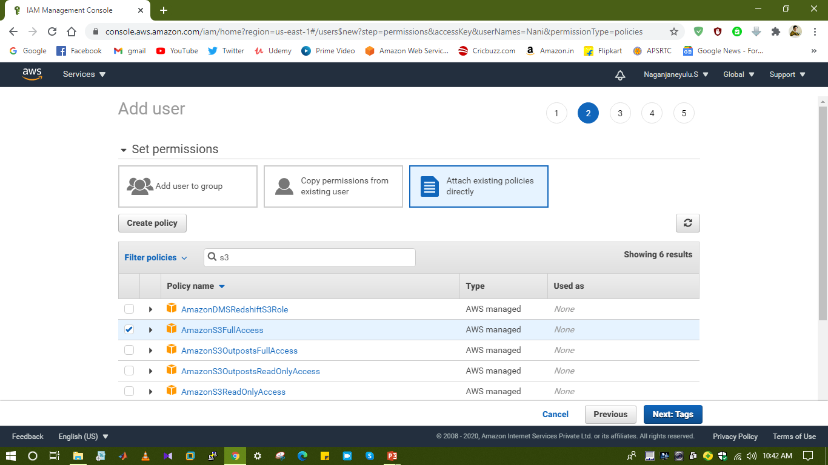

Slide 6
